Slide 1
Blood Visual Abstracts
How I Treat Visual Abstract Template
Notes:
Slide #1. Title

Slide 2
User Guide
This PowerPoint file has been conceived to help Blood Authors prepare their visual abstracts regarding Blood How I Treat articles.
How I Treat articles need to allow the clinical reader to gain greater insight into the biology of the disease and how it shapes clinical decision-making through the synthesis of an expert clinician. Furthermore, these articles provide directions in the therapeutic management of common or complex clinical situations of the disease. The How I Treat articles contain illustrative clinical cases that should enhance their practical usefulness among the readers.
Slide #3 reports a Template for creating a visual abstract:
  Top panel: Non-assertive, Capitalized Title That Defines the Topic for the Average Reader That the Journal Is Trying to Reach (and is not an expert in your field);
  The central field should summarize the Main Points of your How I Treat article: Please limit the text as much as possible and use clear illustrations;
  Bottom panel: Conclusions (1 or 2 Key Points) with DOI (this latter will be added by Blood staff during production).
Your Visual Abstract will be peer-reviewed, and you might be invited to modify/improve it before publication online.
Final edits/adjustments will be made inhouse during production.
Notes:
Slide #2. User Guide

Slide 3
Notes:
Slide #3. How I Treat Visual Abstract Template

Slide 4
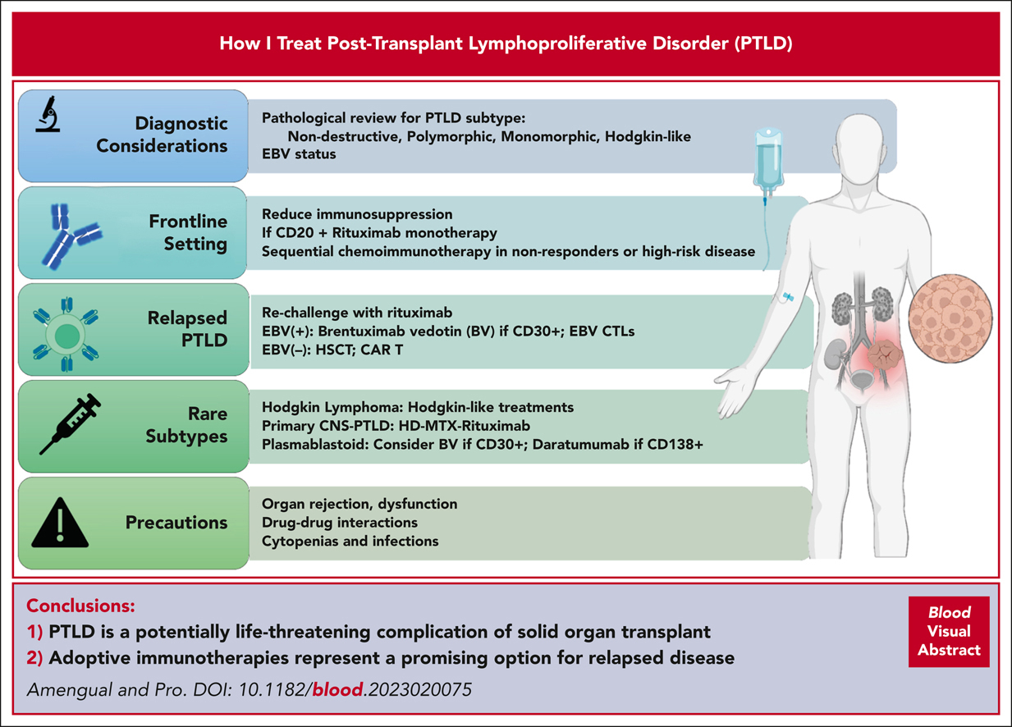

How I treat posttransplant lymphoproliferative disorder
Jennifer E. Amengual,Barbara Pro, How I treat posttransplant lymphoproliferative disorder, Blood, 2023,
Copyright © 2023 American Society of Hematology
Notes:
Blood How I Treat Article

Slide 5
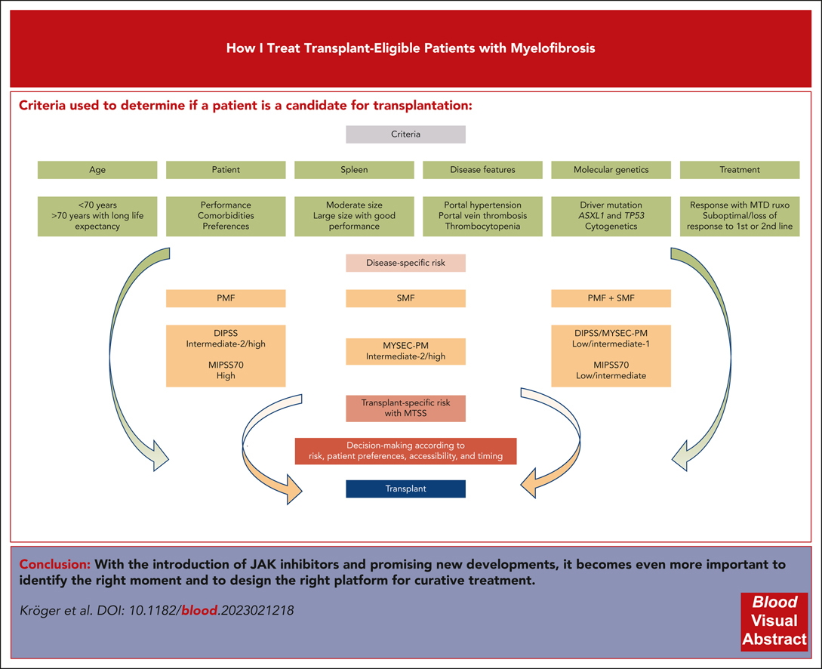
How I treat transplant-eligible patients with myelofibrosis
Nicolaus Kröger,Christine Wolschke,Nico Gagelmann, How I treat transplant-eligible patients with myelofibrosis, Blood, 2023,
Copyright © 2023 American Society of Hematology
Notes:
Blood How I Treat Article

Slide 6
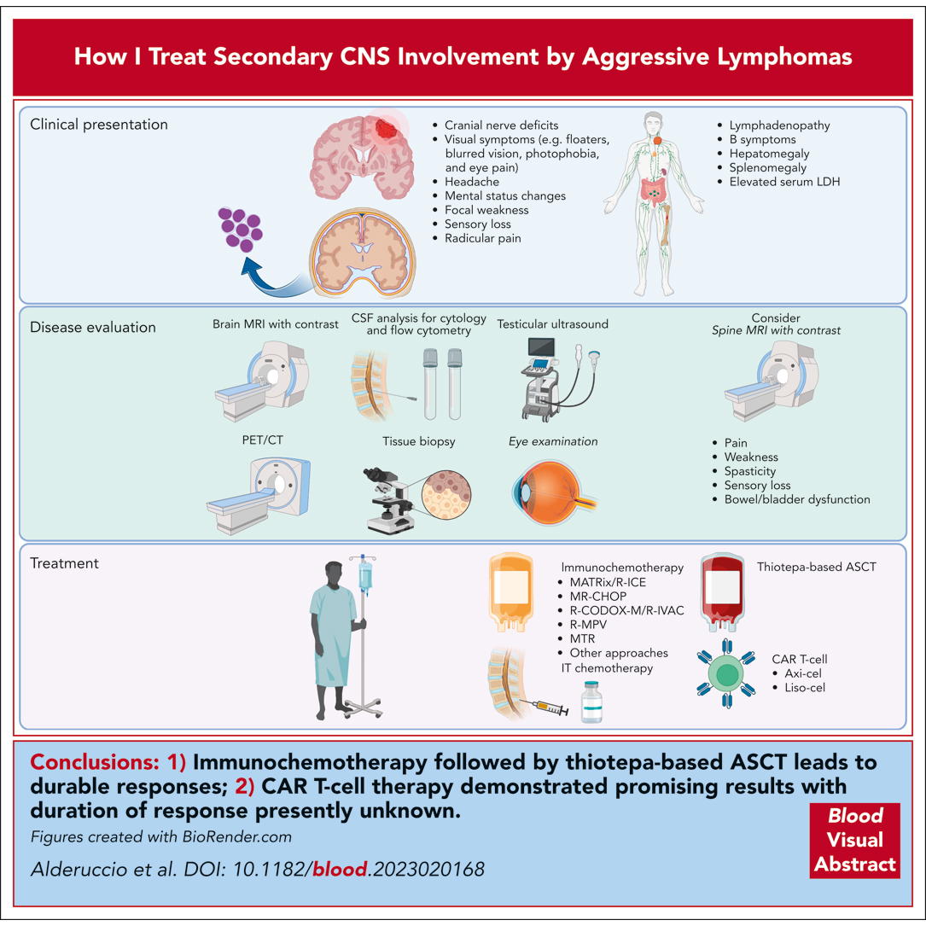
How I treat secondary CNS involvement by aggressive lymphomas
Juan Pablo Alderuccio,Lakshmi Nayak,Kate Cwynarski, How I treat secondary CNS involvement by aggressive lymphomas, Blood, 2023,
Copyright © 2023 American Society of Hematology
Notes:
Blood How I Treat Article

